Slide 1
This Old Man
Student Name
Teacher’s Name

Slide 2
This Old Man
This old man, he played one; He played knick-knack on a drum. With a knick-knack, paddy whack, Give a dog a bone; This old man came rolling home.

Slide 3
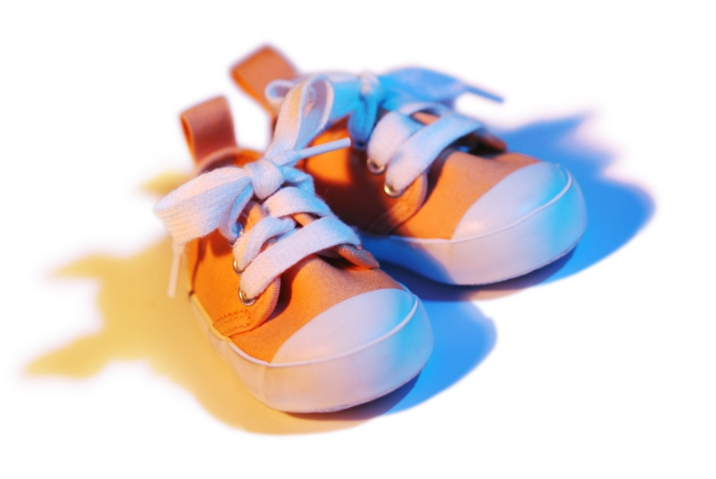
This Old Man
This old man, he played two; He played knick-knack on my shoe. With a knick-knack, paddy whack, Give a dog a bone; This old man came rolling home.

